Slide 1

How to build team spirit ?

Slide 2
Key Points
What is a team ?
What is team spirit ?
How to build team spirit.

Slide 3

What is a team ?
Team is a group of peoples come together to achieve a common goal.

Slide 4
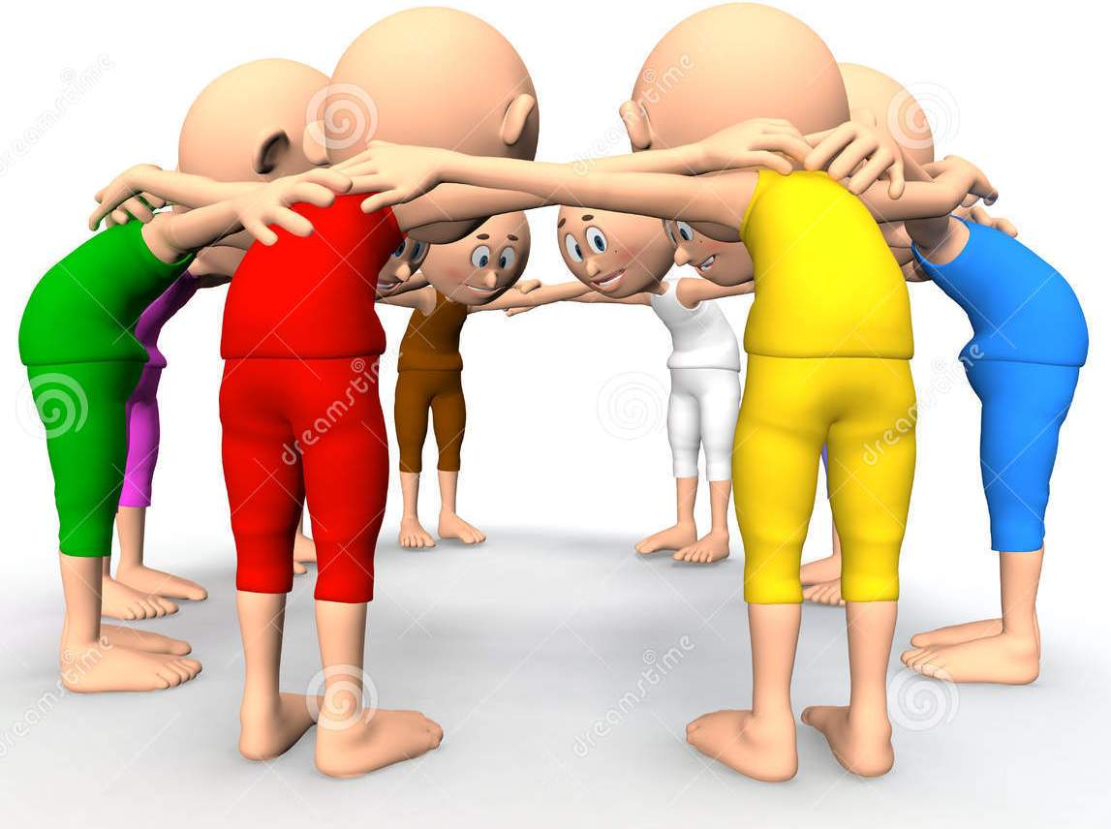
What is team spirit ?
Feelings of affinity among the members of a group, enabling them to cooperate and work well together.
Notes:
camaraderie - mutual trust and friendship among people who spend a lot of time together.
Affinity - a natural liking for and understanding of someone or something.

Slide 5
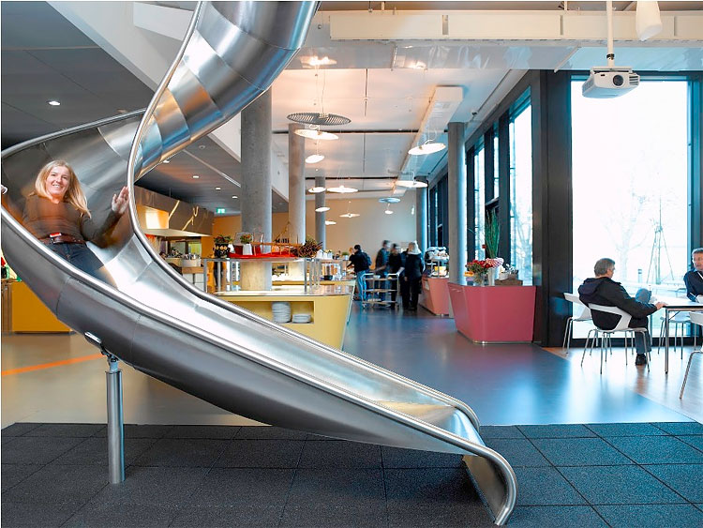
How to build team spirit ?
Build environment

Slide 6

How to build team spirit ?
Know everyone in your team.

Slide 7

How to build team spirit ?
Give them confidence to achieve goal.

Slide 8
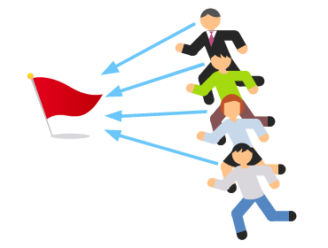

How to build team spirit ?
Give them directions.

Slide 9

How to build team spirit ?
Give them appreciations and value.

Slide 10

How to build team spirit ?
Distribute success

Slide 11

How to build team spirit ?
Celebrate success

Slide 12

How to build team spirit ?
Technique - Reality Distortion Field (RDF)

Slide 13

How to build team spirit ?

Slide 14
Thank You !
Under Guidance of,
Prof. Dr. Churchill P. Samson
Presented by,
Yadnyawalkya Tale 1303052
Priyanka Gaikwad 13030

